Slide 1
CPO code
07/24/24
20200690 Euiseok Han

Slide 2
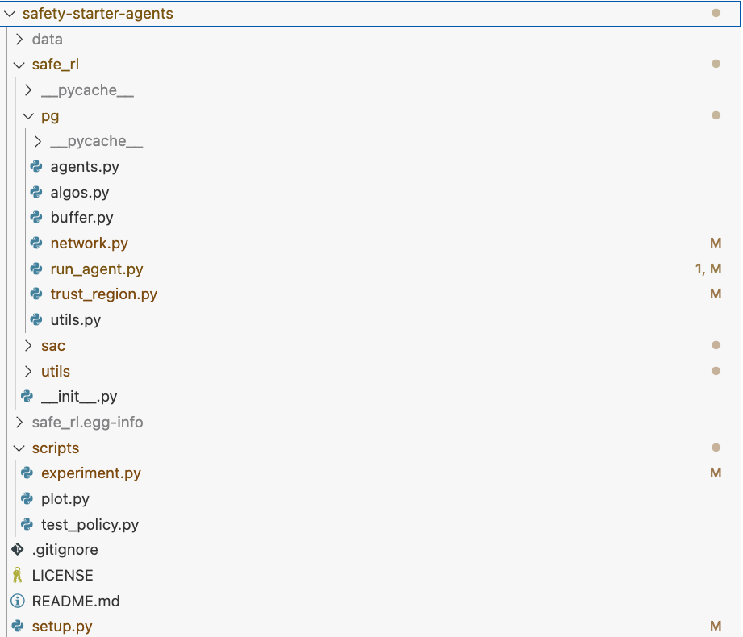
Hierarchy
3
2
4
1

Slide 3
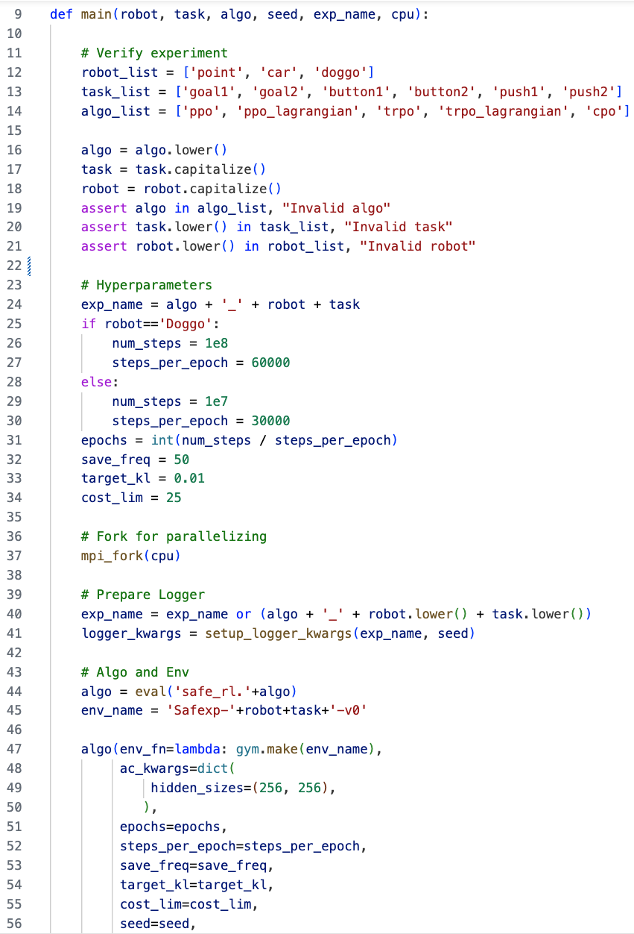
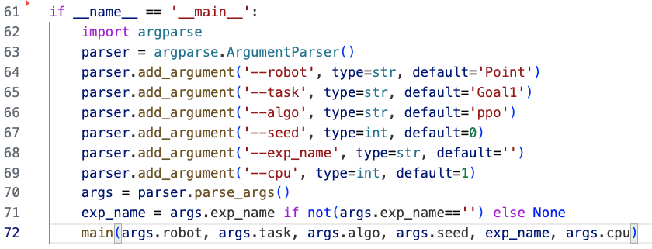
Experiment.py
3
2
4
Algo를 string에서
safe_rl 아래에 해당 algorithm agent를 호출하는 함수로 변경
1
Input data parsing
safe_rl 아래 해당 algorithm agent를 호출

Slide 4
Env description

Slide 5
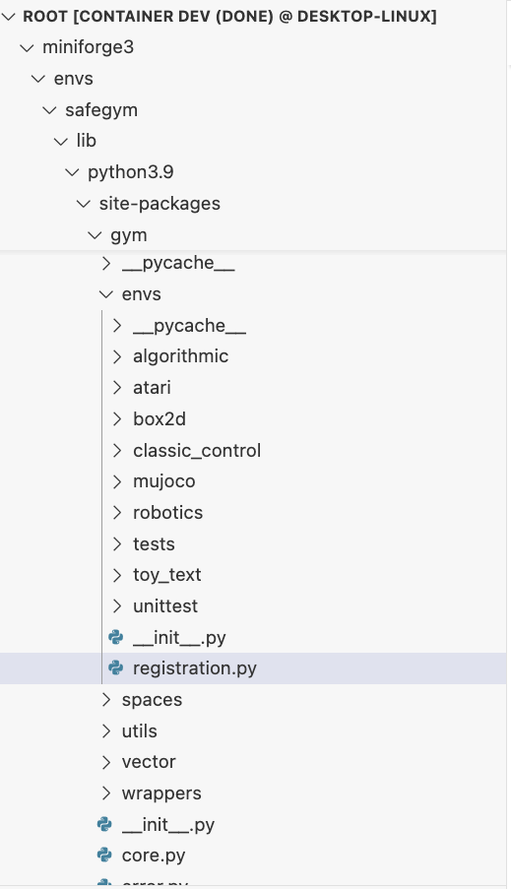
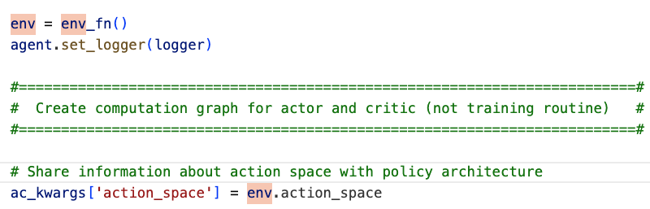
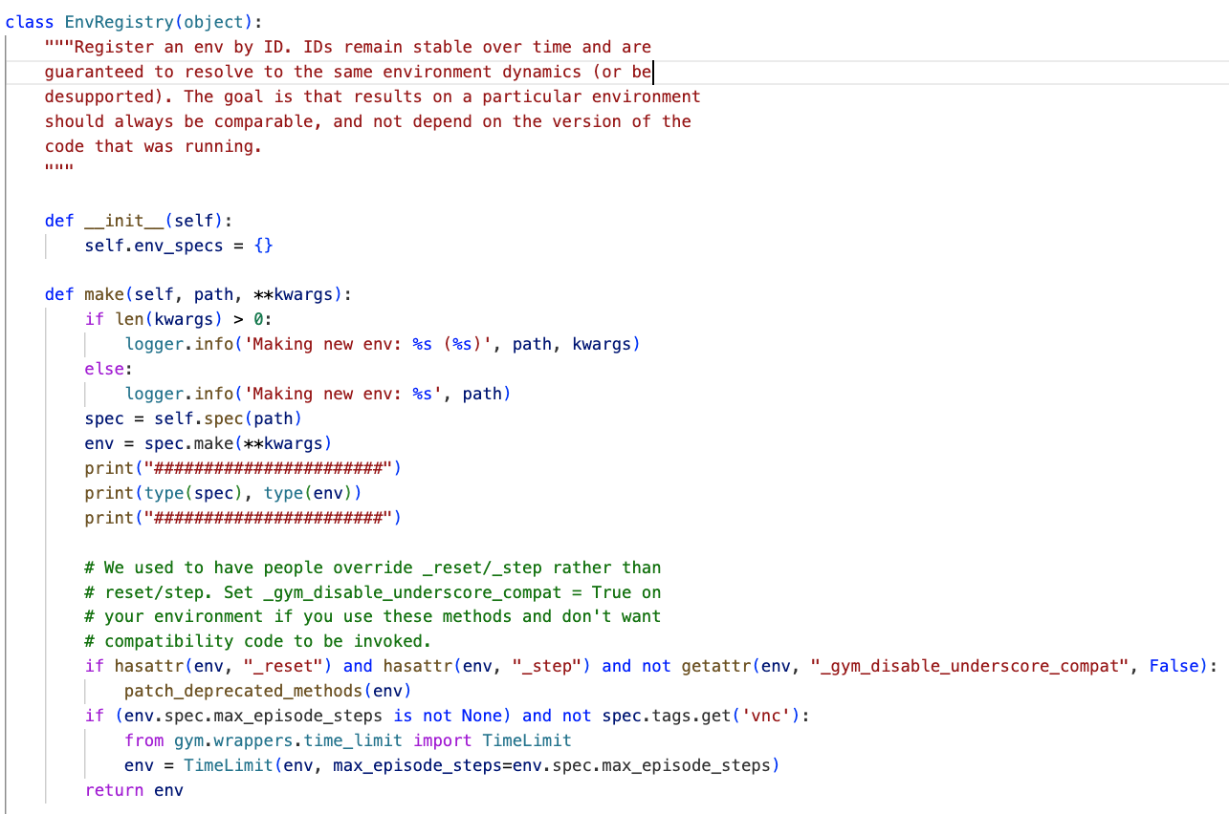
env_fn=lambda: gym.make(env_name)
Run_agent

Slide 6
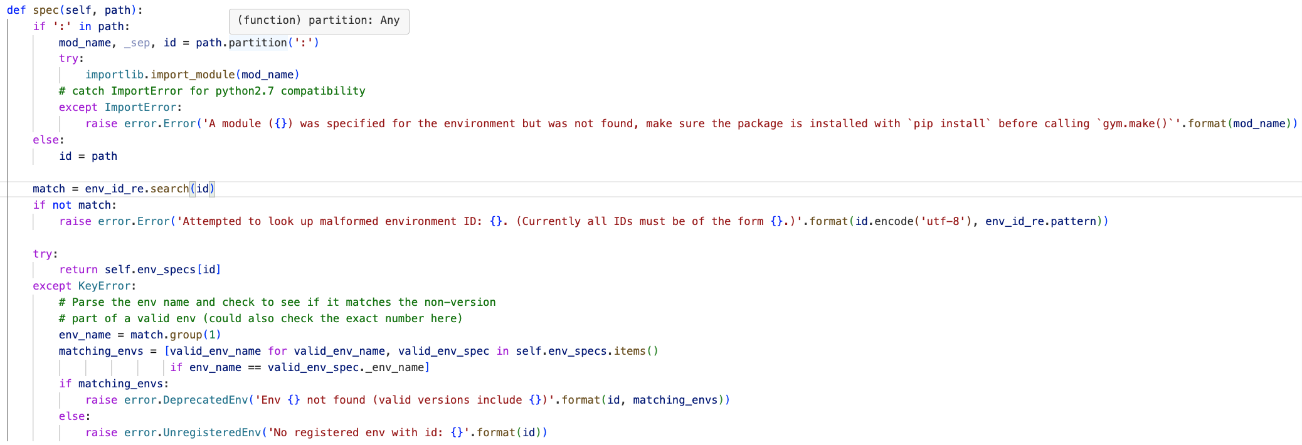
env_fn=lambda: gym.make(env_name)
Class: EnvRegistry

Slide 7
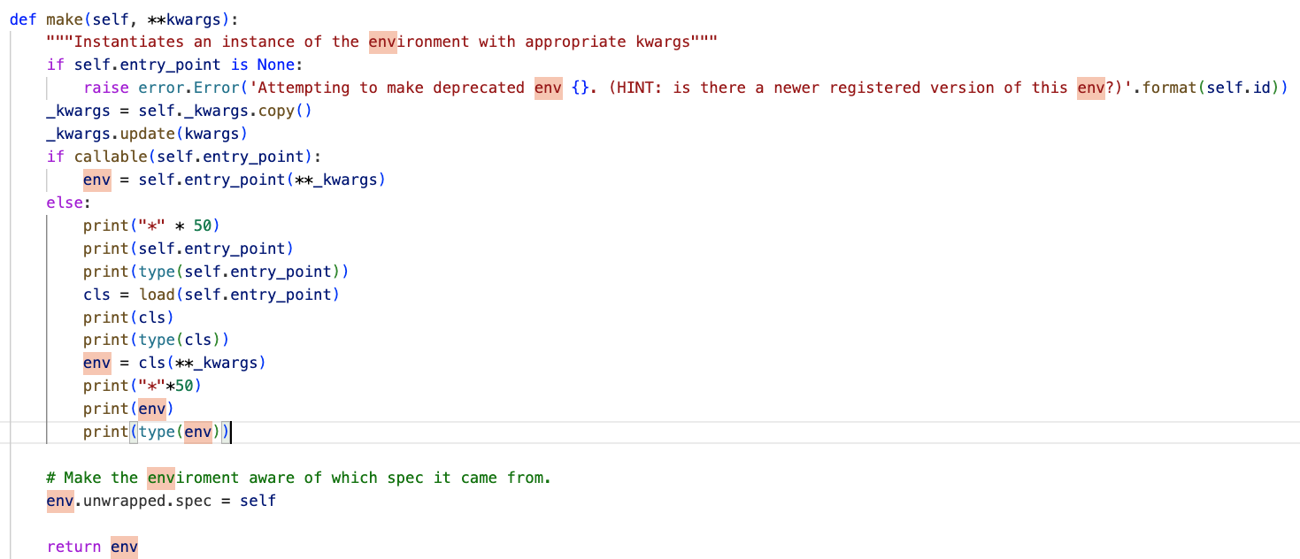
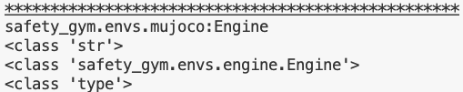

env_fn=lambda: gym.make(env_name)
Class: EnvSpec

Slide 8

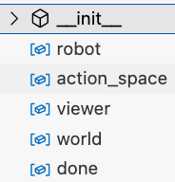
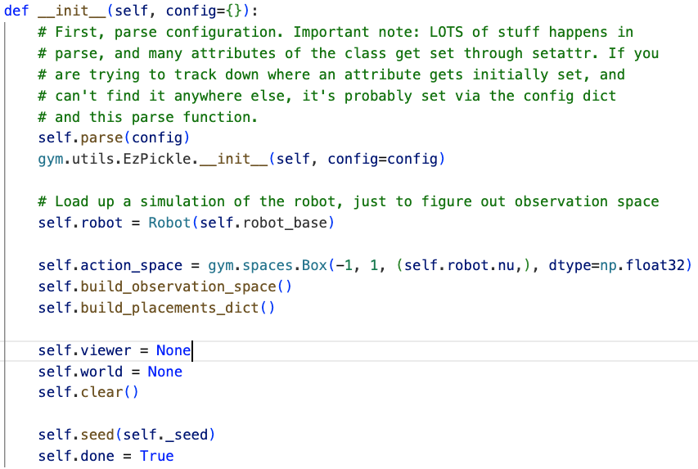
Safety_gym.envs.engine.Engine

Slide 9
Back to algorithm

Slide 10
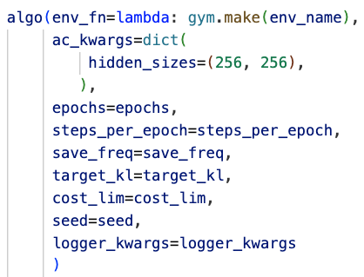

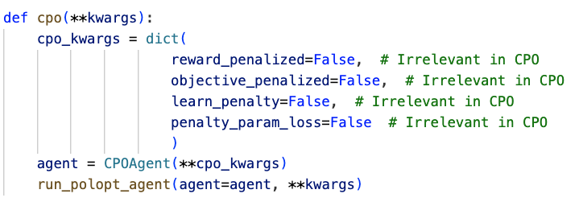
Algos.py
직전 코드
3
2
4
1
CPO Agent 객체 생성

Slide 11
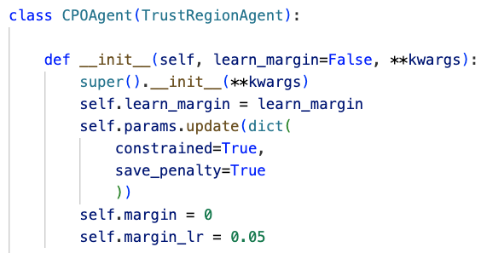
Agents.py
CPO Agent 객체 생성
3
2
4
1

Slide 12
How to calculate expectation?

Slide 13
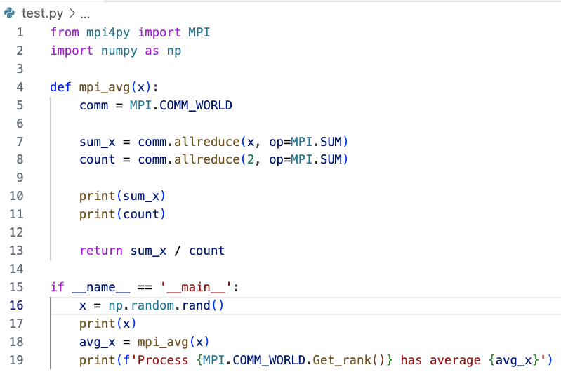
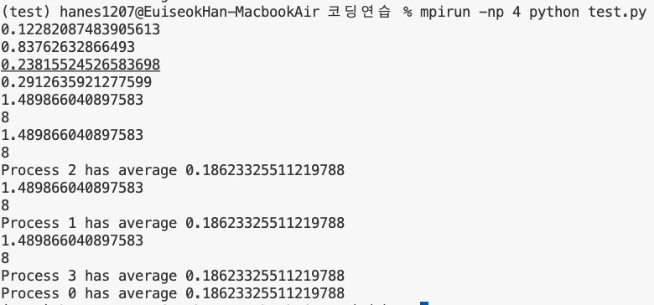
How to calculate expectation?
cpu1
cpu2
cpu3
cpu4

Slide 14
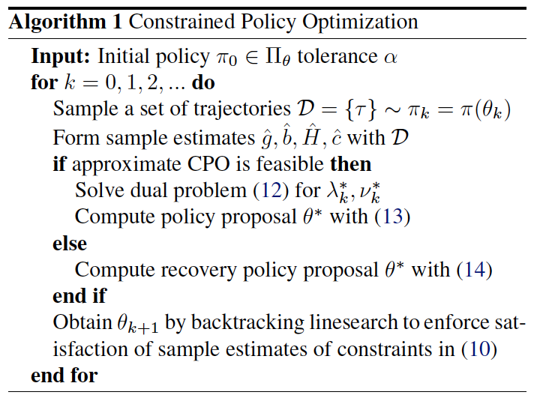
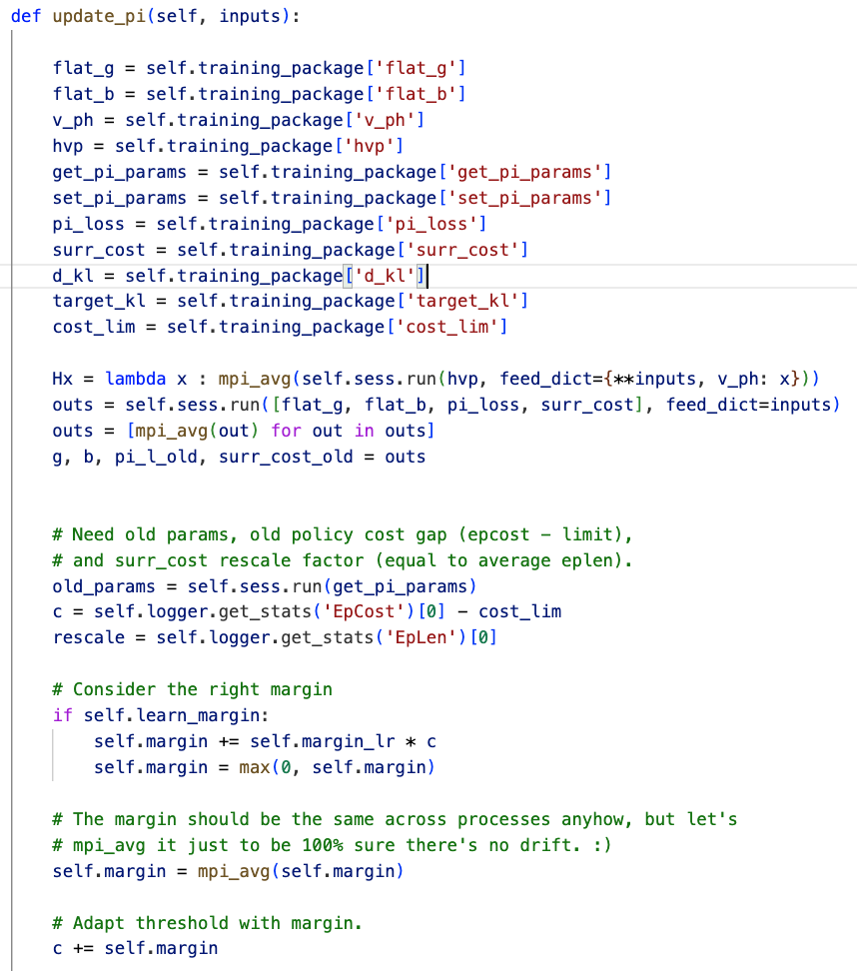
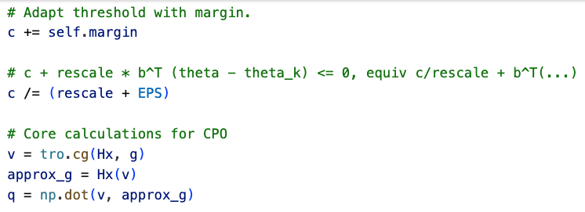
Agents.py
3
2
4
1

Slide 15
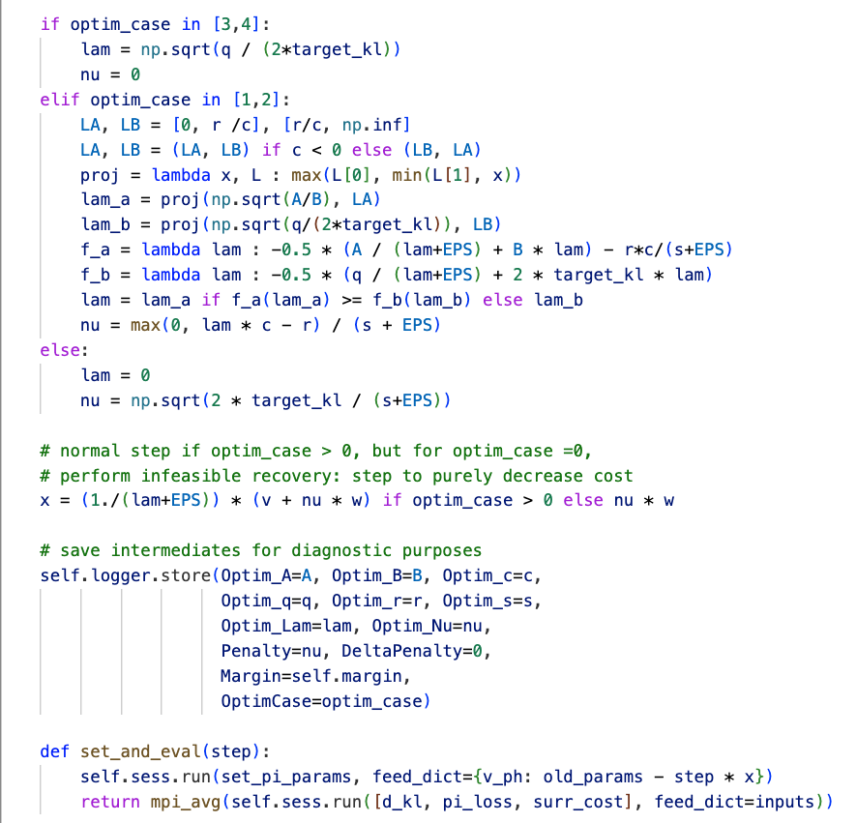
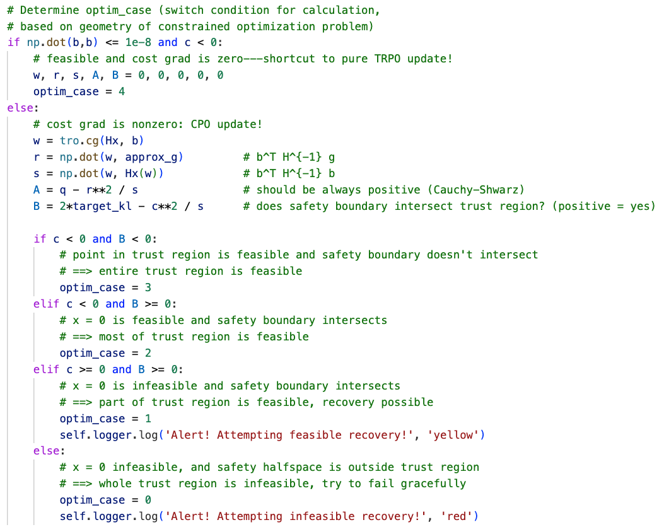
Agents.py
3
2
4
1

Slide 16
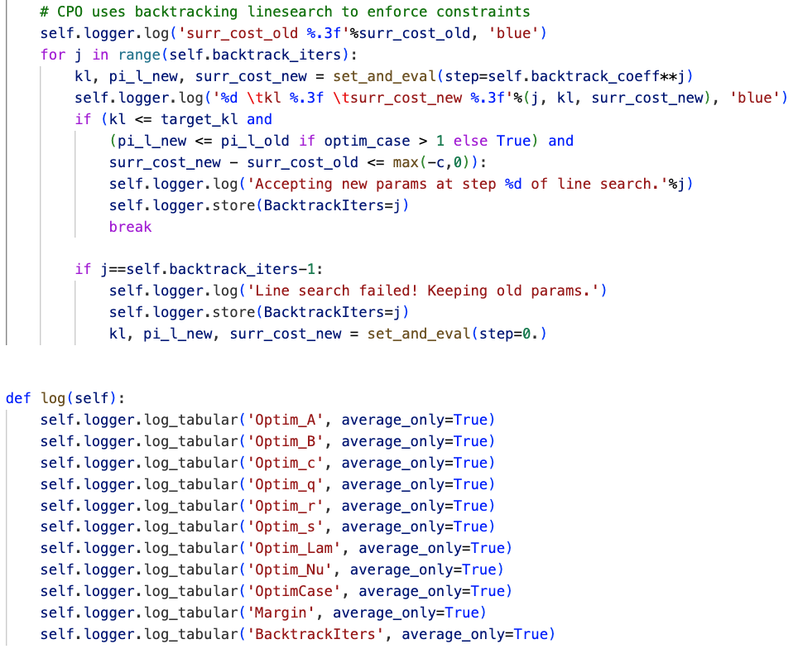
Agents.py
3
2
4
1

Slide 17
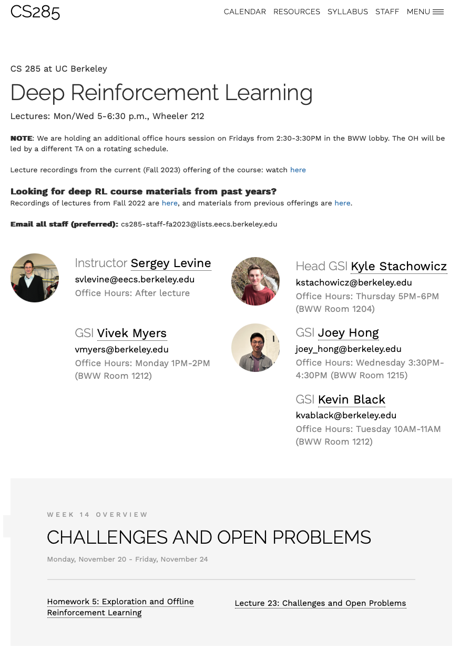
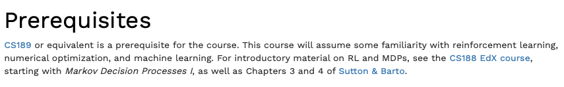
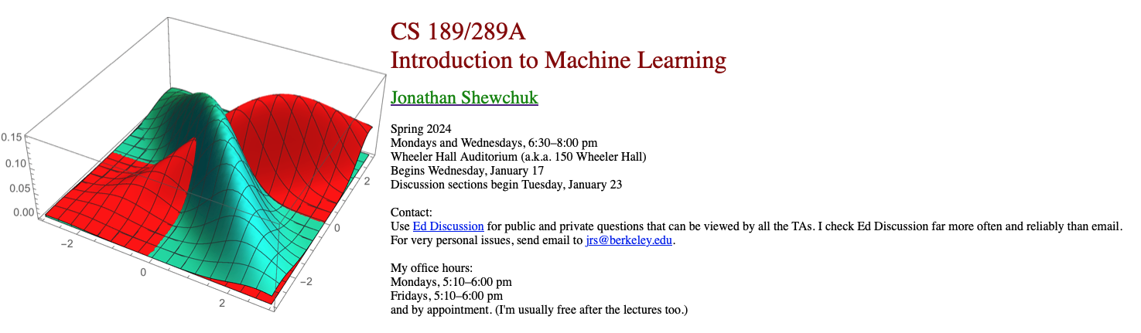

Slide 19
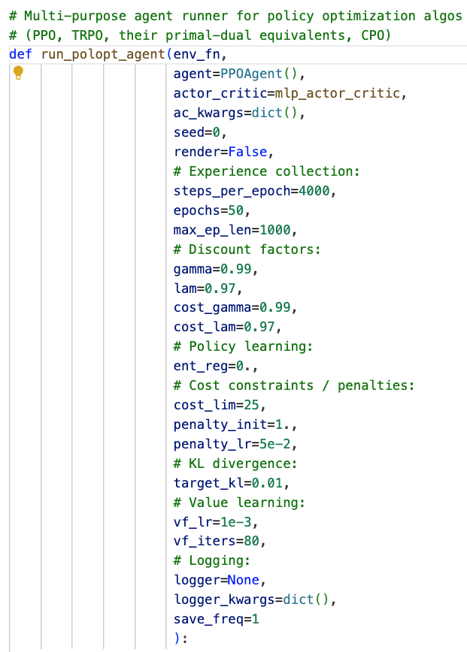
Run.agent.py
3
2
4
1

Slide 20
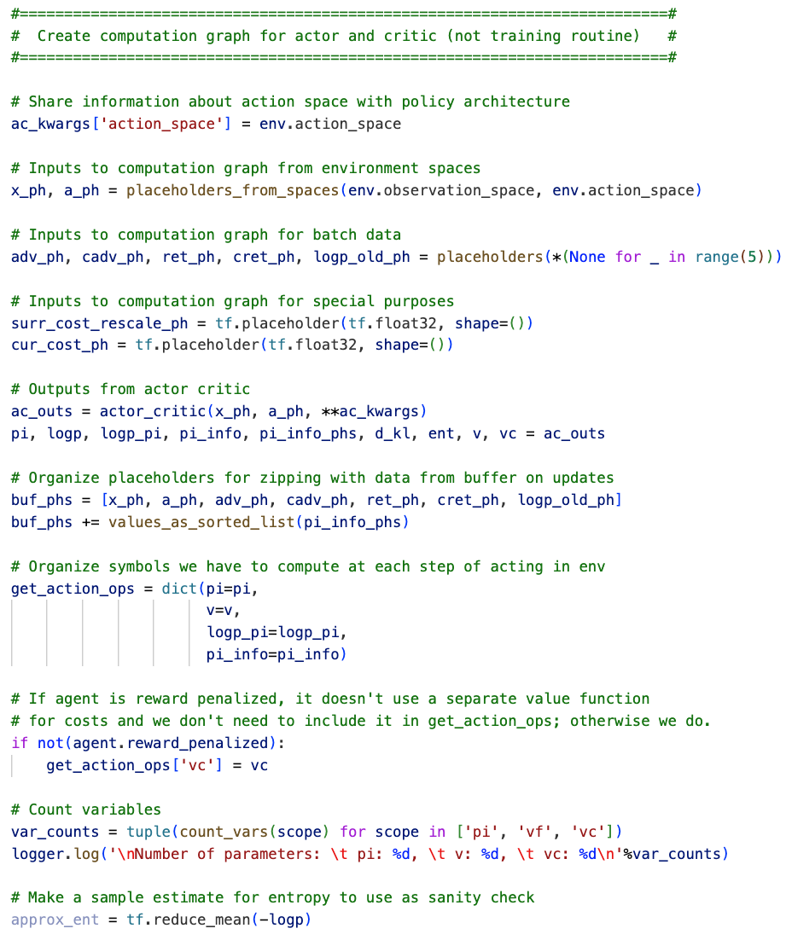
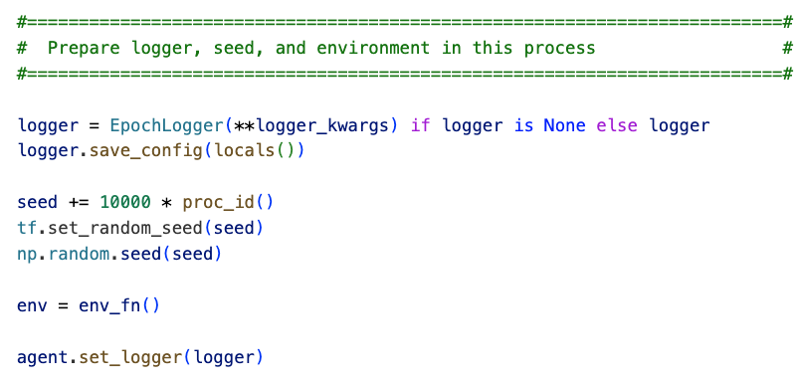
Run.agent.py
3
2
4
1

Slide 21
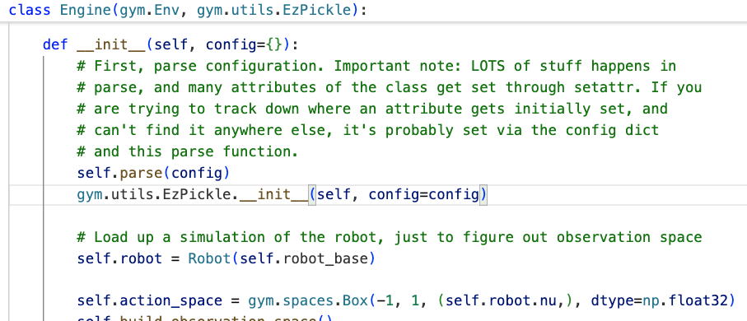
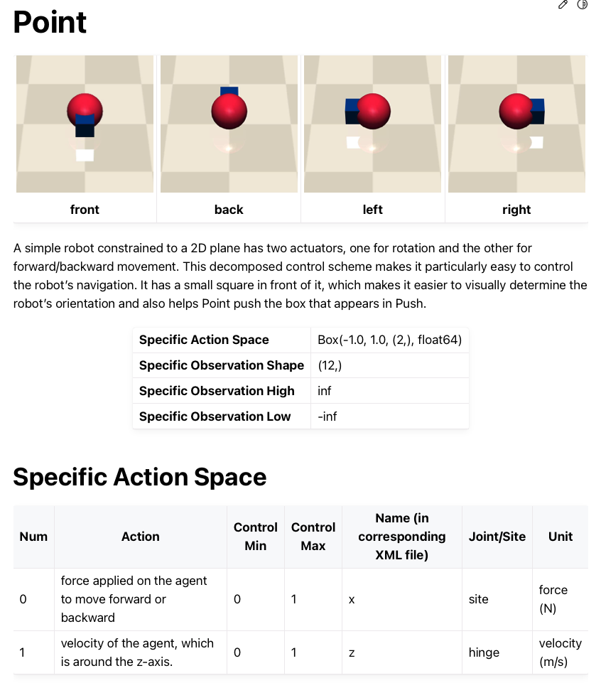
Run.agent.py

Slide 22
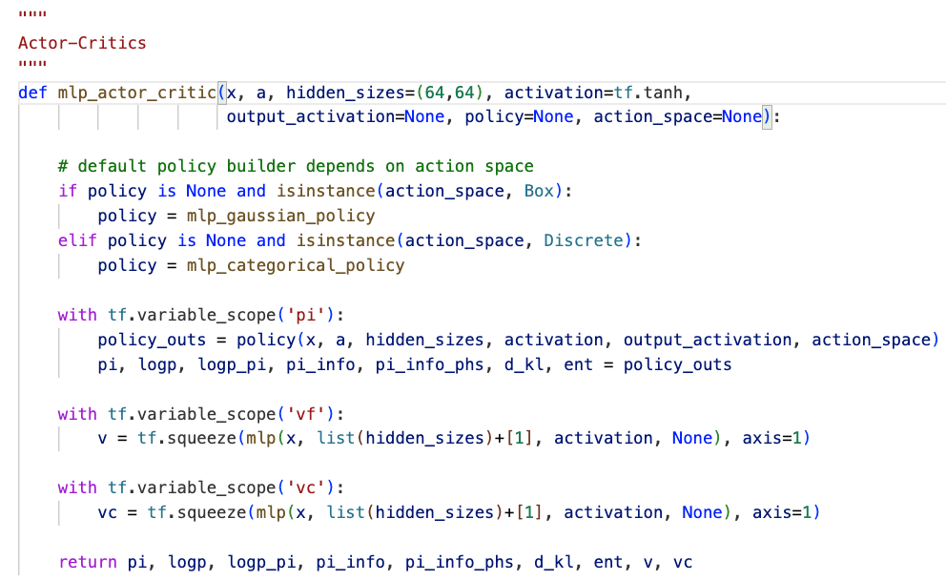
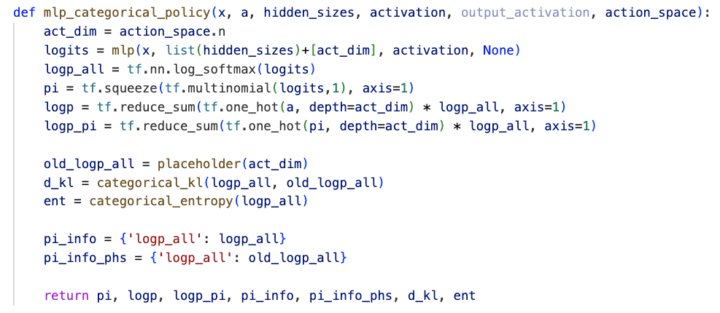
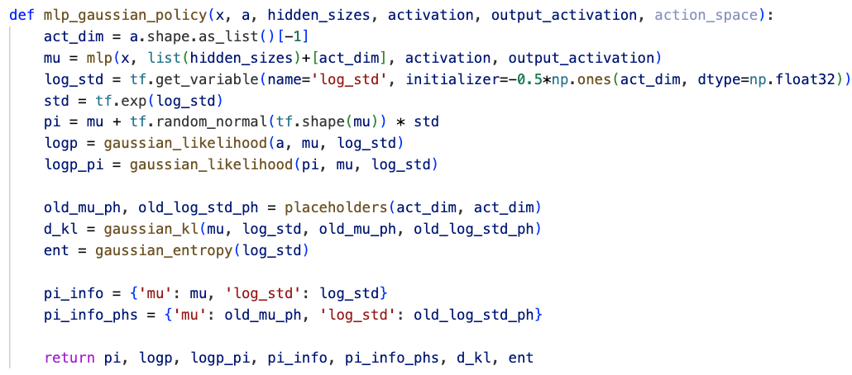
Run.agent.py
…
…
…
observation
action(translation, rotation)
Two hidden layer

Slide 23
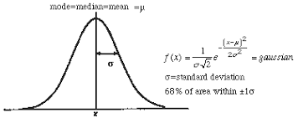
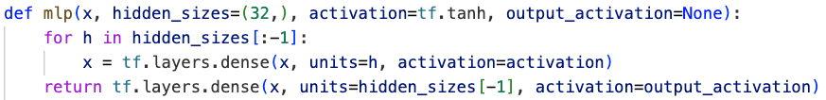
Run.agent.py
…
…
…
a
action
pi
Two hidden layer
logp
logp_pi

Slide 24
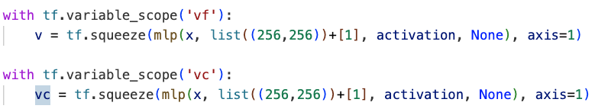
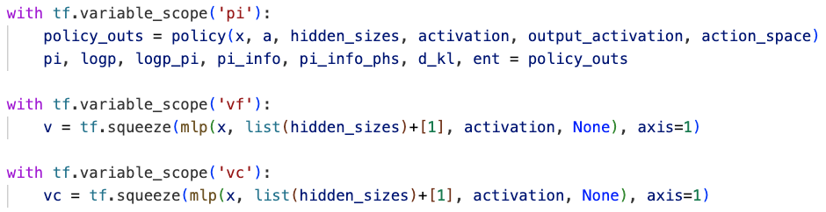
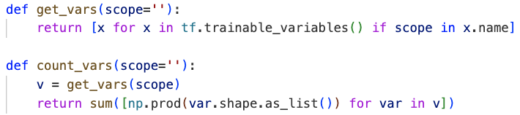
Run.agent.py
adv_ph: advantage function
cadv_ph: cost advantage function
ret_ph: return function
cret_ph: cost return function
…
…
…
observation
v / vc
60*256 + 256 + 256*256 + 256 + 256*1 + 1
=81665
v: value estimated by mlp
vc: cost value estimated by mlp
…
…
…
1
60 nodes?
256 nodes
256 nodes
Trainable lines

Slide 25
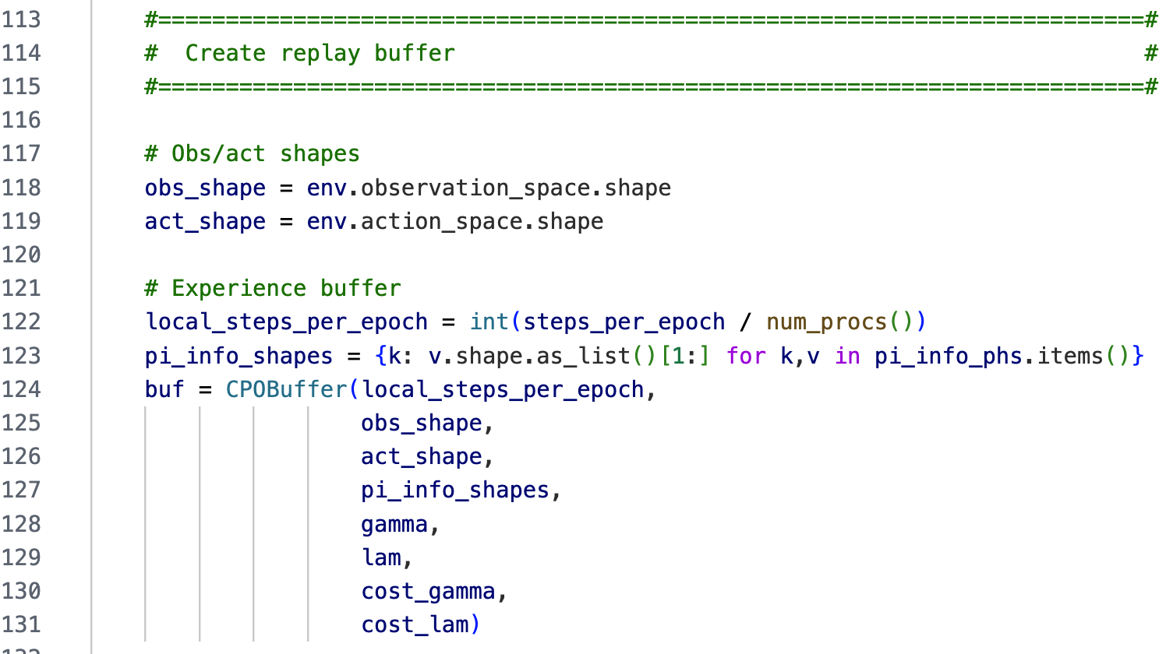
Run.agent.py

Slide 26
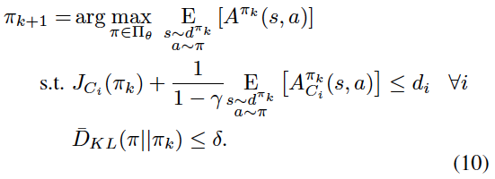
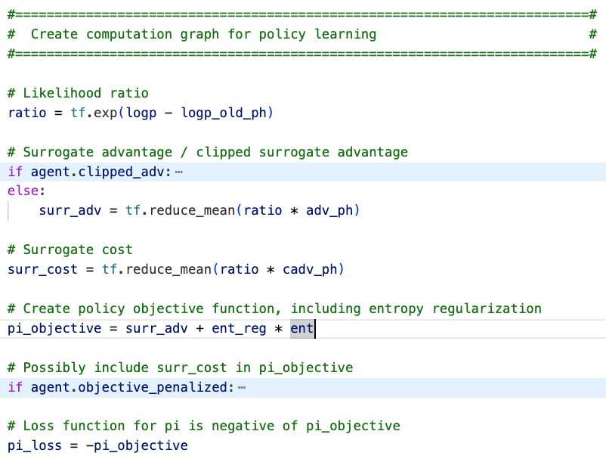




Run.agent.py
Cpo doesn’t use penalty

Slide 27
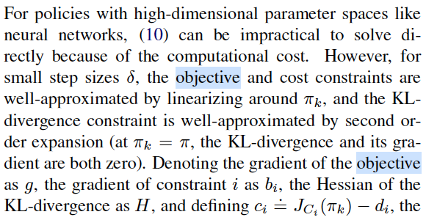
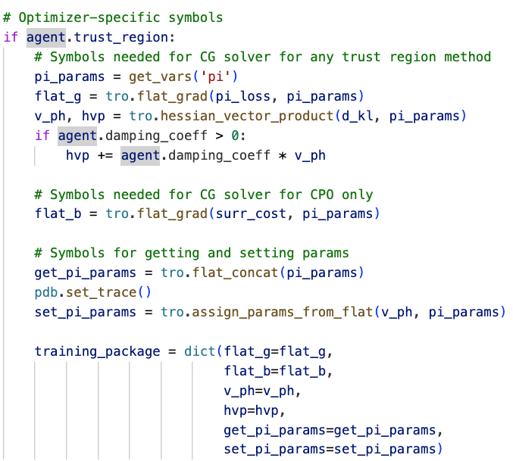
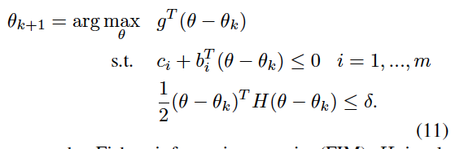
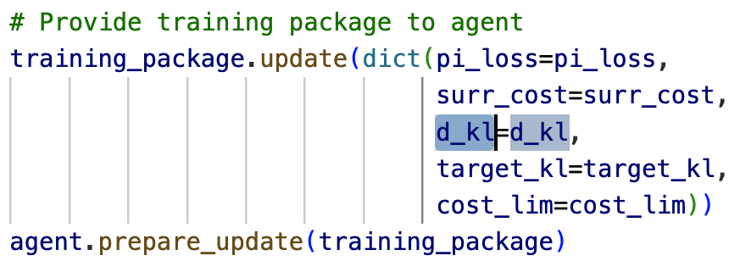
Run.agent.py
…
…
…
get_pi_params
update pi_params according to gradients

Slide 28
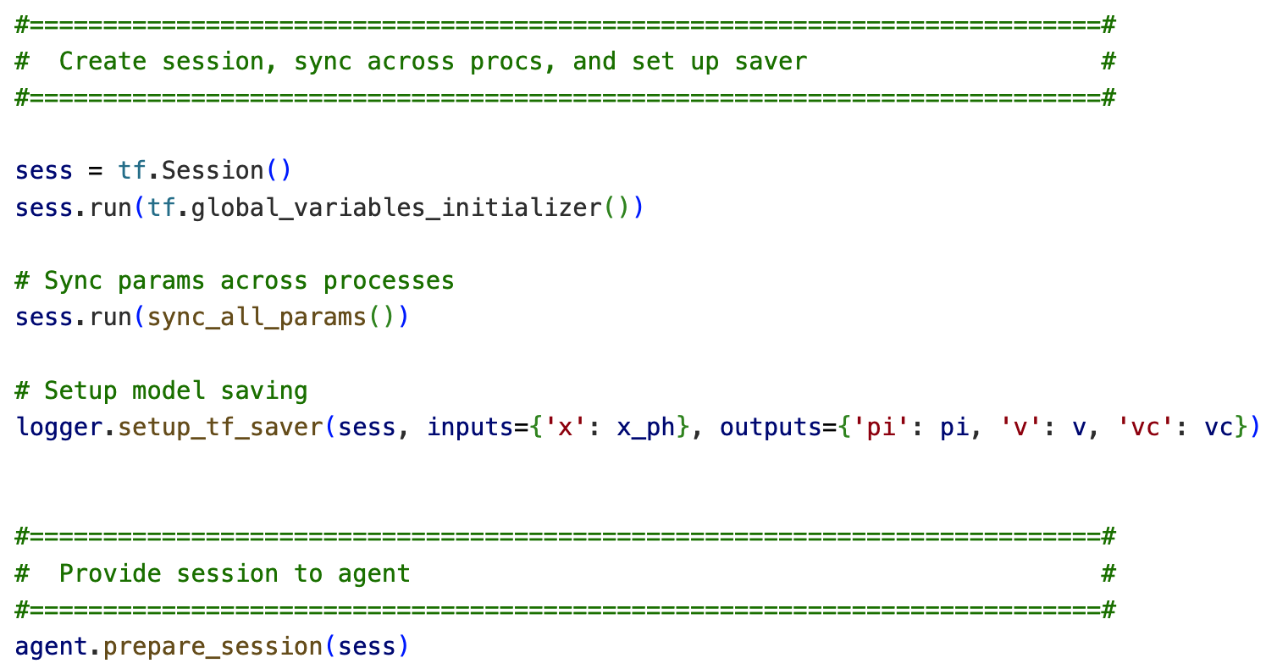
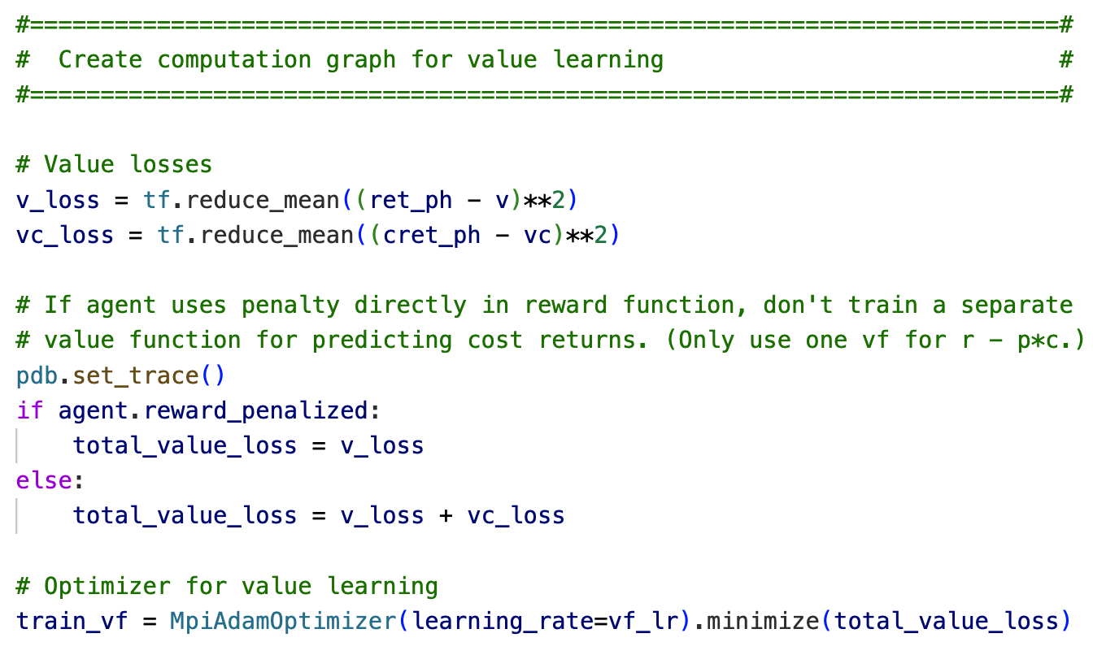
Run.agent.py

Slide 29
Run.agent.py

Slide 30
Run.agent.py

